Slide 1


Butte College
2025-28 Student Equity Plan
Presented by Monica Brown, Student Equity and Achievement Director
Due November 30, 2025

Slide 2
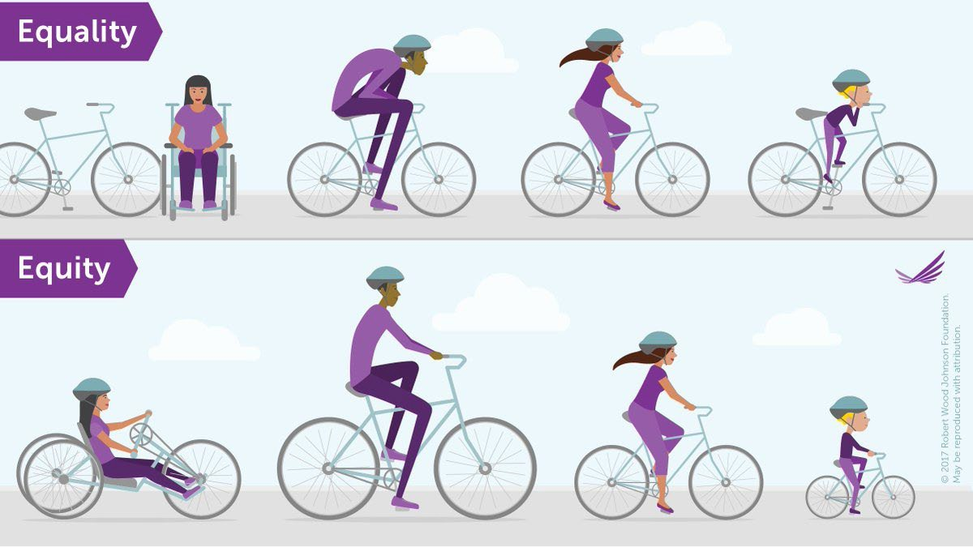
WHAT IS EQUITY?

Slide 3
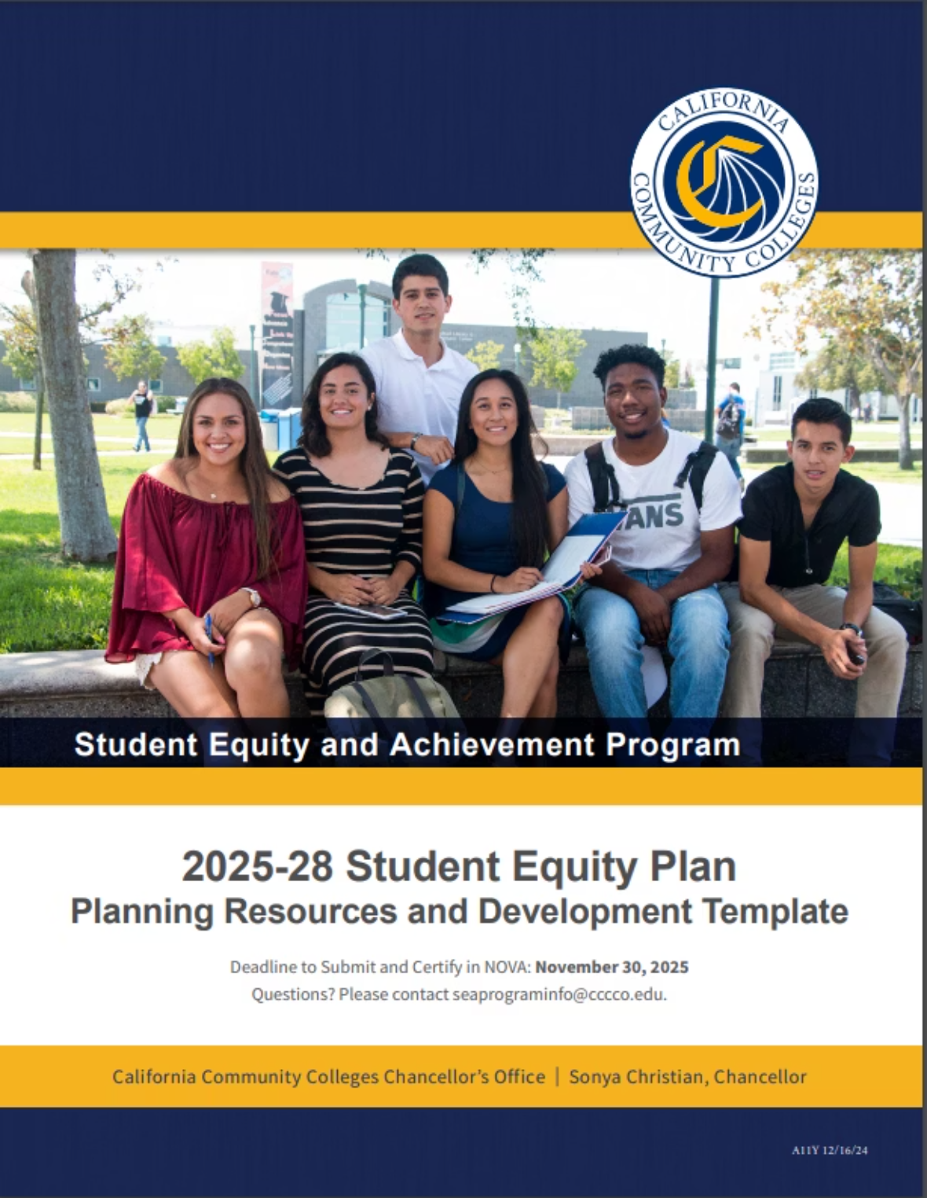
What is a Student Equity Plan?
Student Equity Plans have been required by every California community college since 1992, representing a dynamic, ongoing process aimed at addressing systemic inequities and fostering transformational change.
A Student Equity Plan, per the Chancellor’s Office, is a legally required, data-informed action framework. It involves:
Identifying areas of disproportionate impact for students through data and campus-based research
Setting clear, measurable goals for student groups experiencing disproportionate impact
Defining strategies, grounded in evidence and coordinated across support programs, to close equity gaps
Engaging a broad campus community in both planning and ongoing evaluation
Updating the plan at least every three years and submitting it for systemwide review

Slide 4


2025-28 Student Equity Plan: 13 Components
Section 1: Assurances:
Read Education Codes 78220, 78221, 78222
Campus Involvement and Leveraging Student Voice
Race-Consciousness
Local Review Process and Schedule
Section 2: Contacts
Section 3: 2022-25 Student Plan Reflection: Key Learnings and Plan Continuity
Section 4: Executive Summary
Section 5: Student Populations Experiencing Disproportionate Impact
Sections 6-10: Five Key Metrics
Successful Enrollment,
Transfer-Level Math/English
Persistence
Certificate/Degree Completion
Transfer to 4-year
Section 11: Intensive Focus on DI Populations
The 2025-28 Student Equity Plan emphasizes transformational change through intentional equity work across all institutional areas.
Section 12: Student Education Plans
Section 13: Vision 2030 Equity Alignment

Slide 5

The Five Core Student Equity Metrics
Successful Enrollment
Students who applied and subsequently enrolled at the college
Completion of Transfer-Level Math and English
First-year students who complete both transfer-level courses
Persistence
Students who continue from first primary term to second primary term
Completion of Certificates/Degrees
Each metric requires specific goals and strategies to address equity gaps identified in our student populations.
Students who earn any certificate or degree within a specified timeframe
Transfer to a 4-Year College
Students who successfully transfer to a four-year institution

Slide 6




Disaggregating Student Data by Population
The Studeny Equity Plan requires disaggregation of student data across multiple dimensions to identify equity gaps:
Identity-Based
Economic Status
Special Populations
Race/Ethnicity
Perkins Economically Disadvantaged
First Generation
Gender
Homeless
Foster Youth
LGBT
Students with Disabilities
Veterans
Understanding intersectionality is crucial: students may belong to multiple groups experiencing disproportionate impact, compounding their equity challenges.

Slide 7
DI Student Population | % of Students for Baseline Year | # of students for Baseline Year | Goal #1: Eliminate Disproportionate Impact (DI) |  | Goal #2: Fully Close Equity Gap
 |  |  | % of Increase Needed to Eliminate DI | # of Students Needed to Eliminate DI | % of Increase Needed to Fully Close Equity Gap | # of Students Needed to Fully Close Equity Gap
Successful Enrollment Baseline Year 2022-23
Overall Student Population | 22.6% | 1833 | N/A | N/A | N/A | N/A
Black or African American Male | 16.4% | 23 | .2% | 1 | 6.2% | 9
Completed Both Transfer-Level Math and English in First Year Baseline Year 2022-23
Overall Student Population | 20.9% | 534 | N/A | N/A | N/A | N/A
First Generation | 16.8% | 146 | 3.8% | 34 | 6.3% | 55
Foster Youth | 10.6% | 15 | 5.8% | 9 | 11.0% | 16
White Male | 17.5% | 103 | 1.3% | 8 | 4.5% | 27
Persistence from First Primary Term to Second Primary Term Baseline Year 2021-22
Overall Student Population | 69.3% | 1535 | N/A | N/A | N/A | N/A
American Indian/Alaskan Native | 50.0% | 13 | 0.3% | 1 | 19.5% | 6
Black or African American | 51.1% | 24 | 4.3% | 3 | 18.6% | 9
First Generation Male | 61.9% | 169 | 2.6% | 8 | 8.4% | 24
Foster Youth | 60.0% | 72 | 1.0% | 2 | 9.8% | 12
LGBT Female | 60.7% | 71 | 0.2% | 1 | 9.1% | 11
Completion of Certificate or Degree Baseline Year 2019-20
Overall Student Population | 15.8% | 410 | N/A | N/A | N/A | N/A
First Generation | 11.4% | 105 | 4.9% | 46 | 6.9% | 64
Foster Youth | 10.2% | 16 | 1.3% | 3 | 6.0% | 10
Hispanic | 11.4% | 102 | 4.6% | 41 | 6.7% | 60
LGBT | 10.6% | 19 | 1.1% | 2 | 5.6% | 10
Male | 14.8% | 186 | 0.0% | 1 | 2.1% | 27
Transferred to a 4-Year College Baseline Year 2018-19
Overall Student Population | 28.3% | 341 | N/A | N/A | N/A | N/A
Econ Disadvantaged Male | 23.9% | 104 | 2.9% | 13 | 6.9% | 30
First Generation | 18.7% | 68 | 9.7% | 36 | 13.7% | 50
Hispanic | 23.9% | 84 | 1.7% | 7 | 6.3% | 23
Male | 25.5% | 153 | 2.0% | 12 | 5.5% | 33

Slide 8

Executive Summary Requirements
Student groups for whom goals have been set
Goals set for these student groups
Initiatives that the community college or district will undertake to achieve these goals
Resources that have been budgeted for that purpose (referring to goals/key strategies in this 2025-28 Student Equity Plan)
Community college district official to contact for further information
Detailed accounting of how funding was expended (expenditures from 2022-25 Student Equity Plan)
Assessment of the progress made in achieving identified goals (goals/outcomes from 2022-25 Student Equity Plan)

Slide 9

Developing Strategies for Each Metric
DI Populations Identified by Chancellor’s Office
Establish Equity Goals
Determine which student populations experience the largest equity gaps for each metric.
For each identified student population, set specific, measurable goals for eliminating disproportionate impact and/or fully closing equity gaps
Develop Key Strategies
Consider Overall Population
Create a minimum of three strategies across both instruction and student services to meet established equity goals for each population
Optional: Develop additional key strategies that improve equitable outcomes for the entire student body
Each strategy should be evidence-based, culturally responsive, and aligned with the college's overall mission and vision for equity.

Slide 10
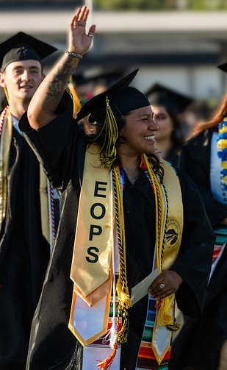
Intensive Focus on Priority Populations
The 2025-28 SE Plan requires identifying 1-3 student populations for intensive focus during the 2025-28 planning cycle:
First-Generation Students
Male Students
Current Challenges & Barriers
1
Identify institutional policies, processes, practices, and cultural elements that create challenges or barriers for the prioritized student populations experiencing disproportionate impact
Comprehensive Action Plan
2
Develop a detailed action plan to achieve goals across all five metrics for the identified student populations, including specific strategies to address identified barriers

Slide 11
Student Educational Plans
The 2025-28 Student Equity Plan requires a comprehensive approach to ensure all students have access to
and complete educational plans that guide their academic journey.
Data Analysis
Review current data on student educational plan completion rates across different demographic groups to identify gaps: Native American Male Students, White Male Students, Latinx Male Students, First Generation Students
COMPREHENSIVE STUDENT EDUCATION PLANS (Local College Data)
Academic Year Cohort (include summer and winter sessions if applicable) | Total Number of Enrolled Students in Cohort | # of Students who Received a Comprehensive Ed Plan by end of First Primary Term | % of Students (out of the total number of students enrolled in cohort) who Received a Comprehensive Ed Plan by End of First Primary Term | # of Students who Received a Comprehensive Ed Plan by end of First Academic Year | % of Students (out of the total number of students enrolled in cohort) who Received a Comprehensive Ed Plan by End of First Academic Year
Fall 2022 Cohort (Comprehensive Ed Plan by 6/30/2023) | 1910 | 502 | 26.3% | 692 | 36.2%
Spring 2023 Cohort (Comprehensive Ed Plan by 12/31/2023) | 337 | 88 | 26.1% | 113 | 33.5%
Fall 2023 Cohort (Comprehensive Ed Plan by 6/30/2024) | 2034 | 547 | 26.9% | 710 | 34.9%
Spring 2024 Cohort (Comprehensive Ed Plan by 12/30/2024) | 395 | 116 | 29.4% | 135 | 34.2%
Streamlined Processes
Develop strategies to integrate educational planning into multiple student touchpoints, especially for DI populations
Educational plans serve as roadmaps for student success and must be accessible and meaningful for all students, particularly those from disproportionately impacted groups.

Slide 12



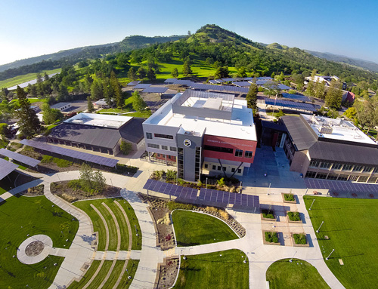
Vision 2030 Equity Alignment and Coordination
The Student Equity Plan must align with and complement other campus initiatives and programs:
Guided Pathways
Student Financial Aid
DSPS
EOPS/CalWORKs
NextUp/Foster Youth: Inspiring Scholars
Veterans Resource Center
Justice-Impacted Students: Rising Scholars
Low-Income Adults: CASA, EOPS, Fin Aid, MESA
Credit for Prior Learning
Dual Enrollment
Strong Workforce Program
Successful implementation requires intentional coordination across campus to create a cohesive ecosystem
of support that addresses equity gaps at every student touchpoint.

Slide 13
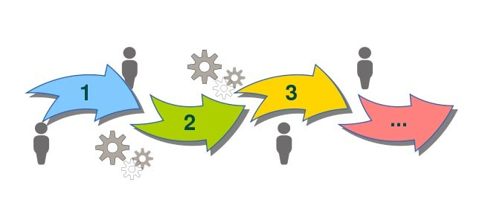
The 2025-28 SE Plan Development Process
Most sections of the 2025-28 SE Plan were drafted by the Student Equity and Achievement Program Advisory Committee (SEAPAC) in spring 2025
SEAPAC consisted of 32 voting members including Faculty, Classified, MSC, Students, Community Members, and non-voting stakeholders
Worked on SE Plan in Metric Design Teams at March, April, May SEAPAC meetings
One-day retreat in May to develop the Plan that included SEAPAC members and other stakeholders
SEA Director met with program managers listed in sections 12 and 13 to develop those parts of the Plan
SEA Director attended the Student Leadership Academy in July to get more student input for the transfer section
All sections were reviewed and many were revised by Dean Tammera Shinar
Constituent group review and approval in September 2025 (Classified Senate, Academic Senate, Student Senate, MSC)
Board of Trustees review in October 2025, vote for approval in November 2025
Submitted to Chancellor’s Office through NOVA by November 30, 2025

Slide 14


