Slide 1
CCSSE Overview and Mapping to SLOs
(Community College Survey of Student Engagement)
Alan Raetz, Research Analyst, Butte College Institutional Research
November 7th 2023

Slide 2
The Community College Survey of Student Engagement (CCSSE)
A yearly nationwide survey of 438 community colleges, including Butte College
An assessment tool that provides information on student engagement, a key indicator of learning
Assesses institutional practices and student behaviors that are highly correlated with student learning and retention
Allows comparison of Butte College to other community colleges that administer the survey

Slide 3
Butte College CCSSE Participation
  Butte College participated in 2008, 2011, 2014, 2017 and 2022
  50 minute in-class pencil-and-paper survey (90%)
  10% respondents from online
  Spring 2022: Over 700 Butte Students surveyed

Slide 4
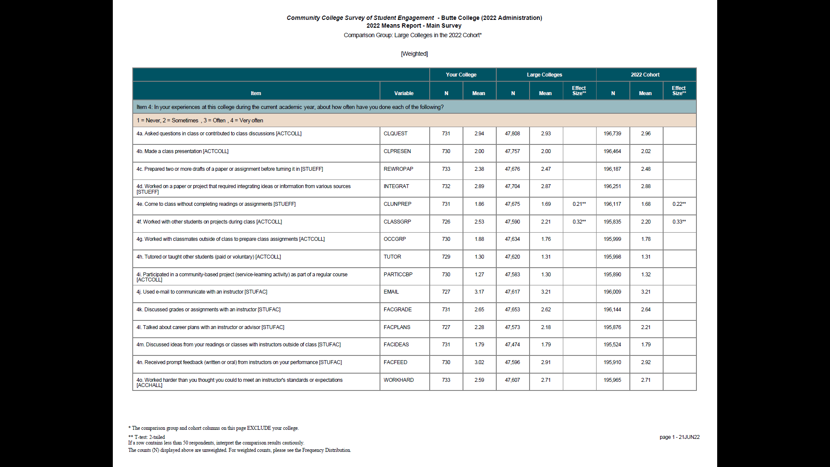
Example:

Slide 5
Mapping Student Survey Responses to Student Learning Objectives
CCSSE maps survey questions to 5 areas of student engagement
  Active and Collaborative Learning
  Student Effort
  Academic Challenge
  Student-Faculty Interaction
  Support for Learners
We have re-mapped individual survey questions into SLO/ILO categories
  Communicate Competently
  Engage Collaboratively
  Think Critically
  Work Effectively

Slide 6
Example: Communicate Competently SLO scoring (average all responses in survey questions mapped to this category)

Slide 7
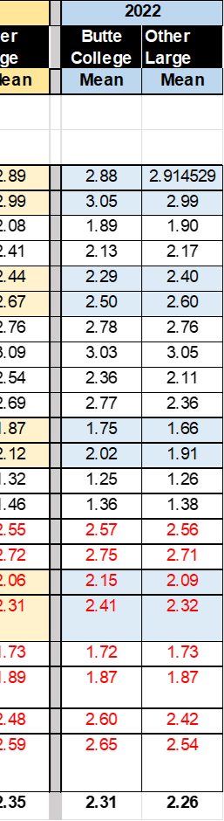
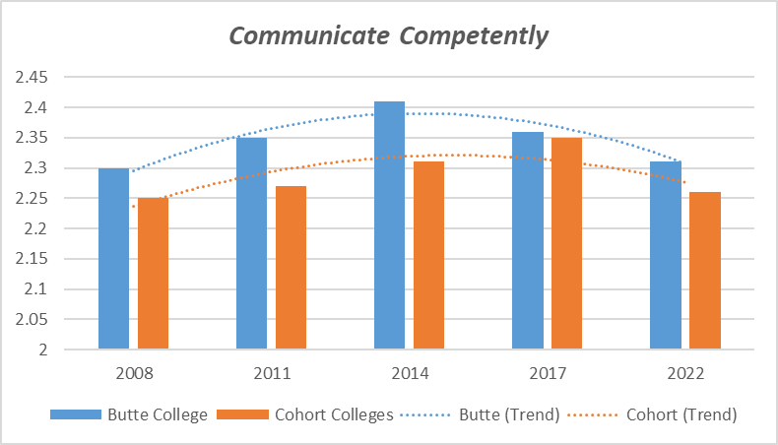
Summarize CCSSE SLO Trends Over Time
Summary Data
 | Butte College | Cohort Colleges
2008 | 2.3 | 2.79
2011 | 2.35 | 2.79
2014 | 2.41 | 2.35
2017 | 2.36 | 2.27
2022 | 2.31 | 2.26

Slide 10
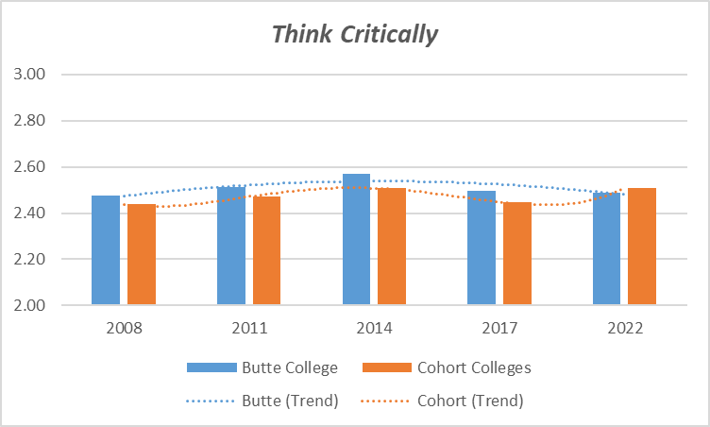

Slide 12
Racial Differences in Collaborative Learning

Slide 13
Reduced Academic Effort from 2017 to 2022

